Slide 1
SALES DATASET ANALYSIS
KIRAN M
DA&DS
MAY BATCH

Slide 2
Project Overview & Objectives
Project Objective: Leverage data-driven insights to enhance sales strategies and operational efficiency. Identify growth opportunities, optimize revenue, and develop predictive sales models.
Goals:
  Analyze sales trends over time.
  Identify underperforming products and suggest improvement strategies.
  Optimize discount strategies to maximize profitability.
  Enhance reporting efficiency through automated excel tools.

Slide 3
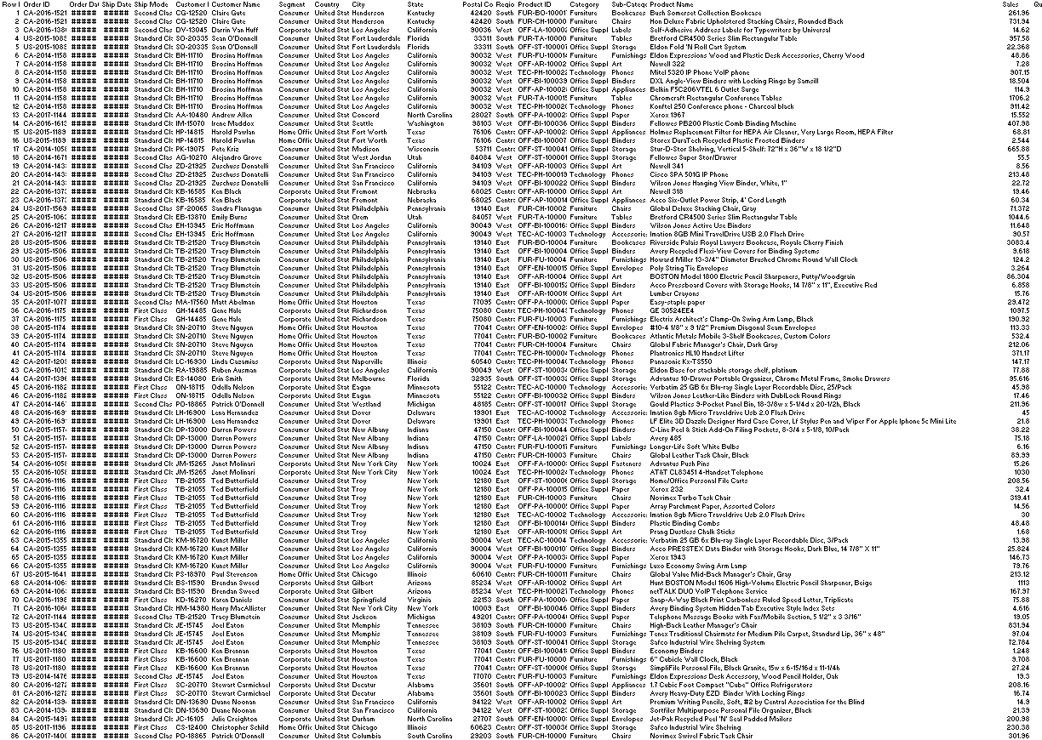
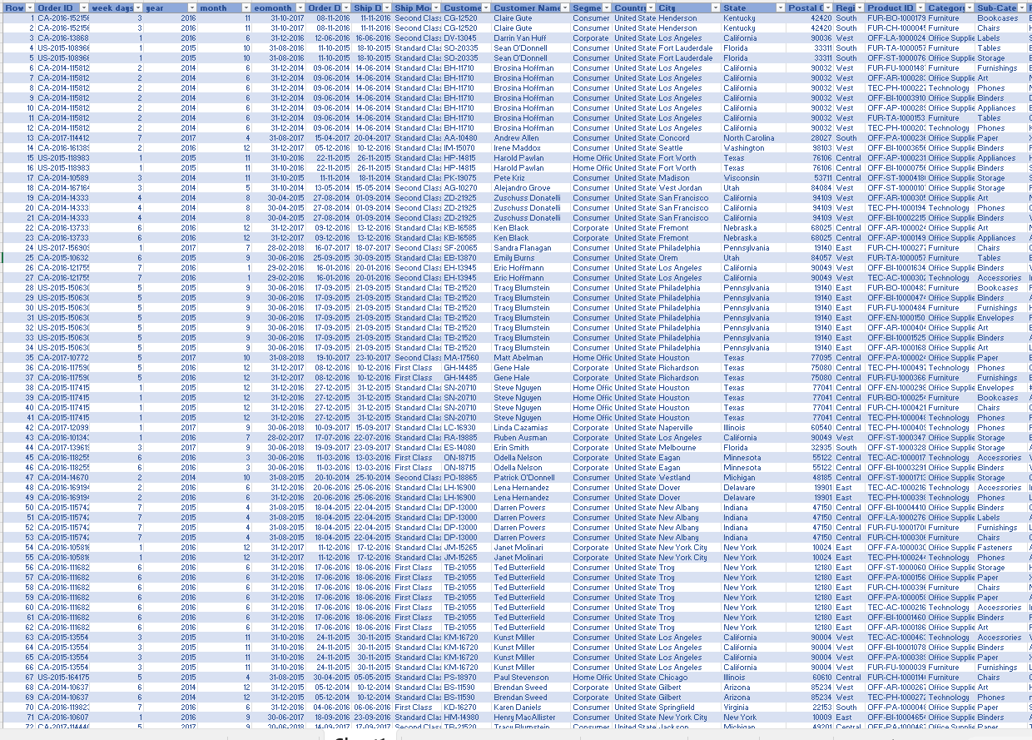
Data Description and Preparation
Remove duplicates &handled missing values.
Formatted data for better readability.
Used power query for transformation.

Slide 4
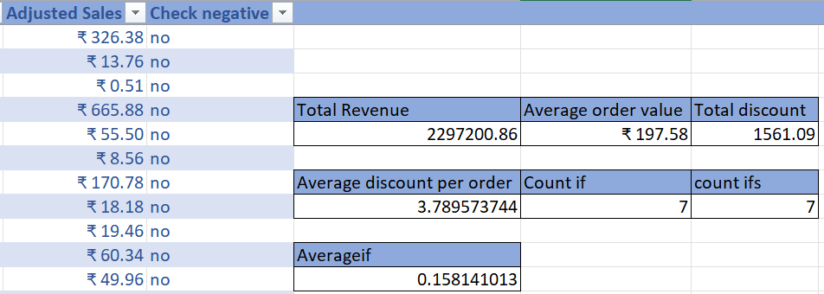
Key Metrics Calculation and Data Analysis
Important Calculations:
  Total sales (=SUM(sales))-
  Average order value(=AVERAGE(adjusted sales))
  Total Discount (=SUM(discount))
  Average discount per order(=AVERAGE(quantity))
  Adjusted Sales(=[@Sales]*(1-[@Discount]/100))

Slide 5
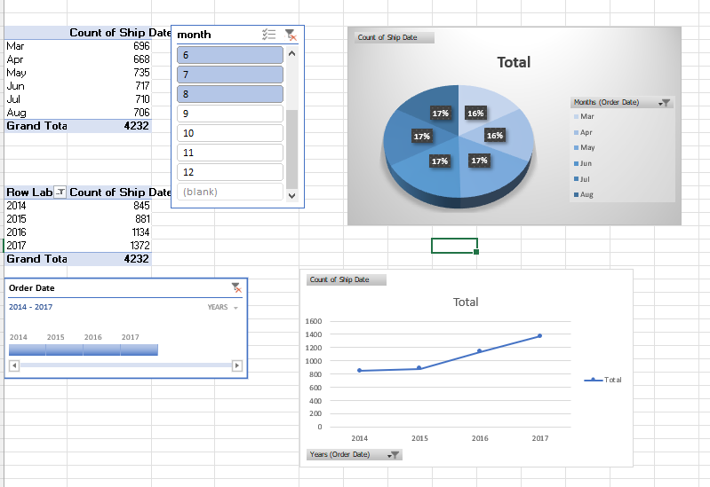
Pivot Tables and Pivot Charts
Created pivot tables for analysis
Used charts to visualize trends
Compared sales by order, return and year
Made data easy to understand

Slide 6
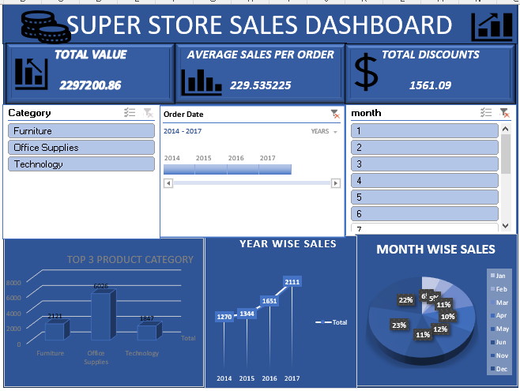
Dashboard Overview
Shows key performance metrics
Include sales per yar and products
Interactive with slicers

Slide 7
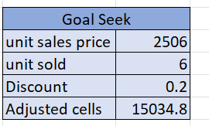
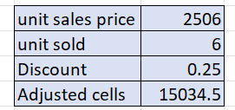
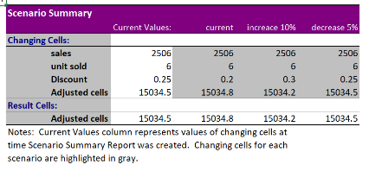
What-If Analysis & Goal Seek
Analyzed profit variations
Helped in business planning
Impact of a 10% price increase on revenue
Impact of a 5% price decrease on revenue

Slide 8
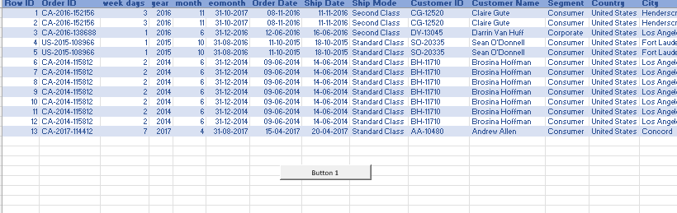
Macros and Automation
Automating data formatting and calculations.
Creating reports and updating charts.
Save time, reduces errors, and improves efficiency

Slide 9
Insights and Recommendations
Insights: The Superstore experienced significant overall growth in sales, particularly in the Technology category. Seasonal trends indicate a need for promotional strategies during slower months to maintain sales momentum.
Recommendations: Boost Office Supplies and Furniture Sales Since Office Supplies and Furniture categories are performing comparatively lower than Technology, it is recommended to implement targeted promotional campaigns for these categories. Consider bundling offers, limited-time discounts, or season-based promotions to improve their visibility and sales performance.

Slide 10
Conclusion and Questions
Sales analysis: Aids decision-making by identifying trends and optimizing strategies.
Data visualization: Simplifies reporting for quick and clear insights.
Predictive analysis: Forecasts trends for future business growth.
Any Questions?

Slide 11
THANK YOU…

